Slide 1
Nashville Cemetery: An Early Record of Disease and War
Adam Crank

Slide 2
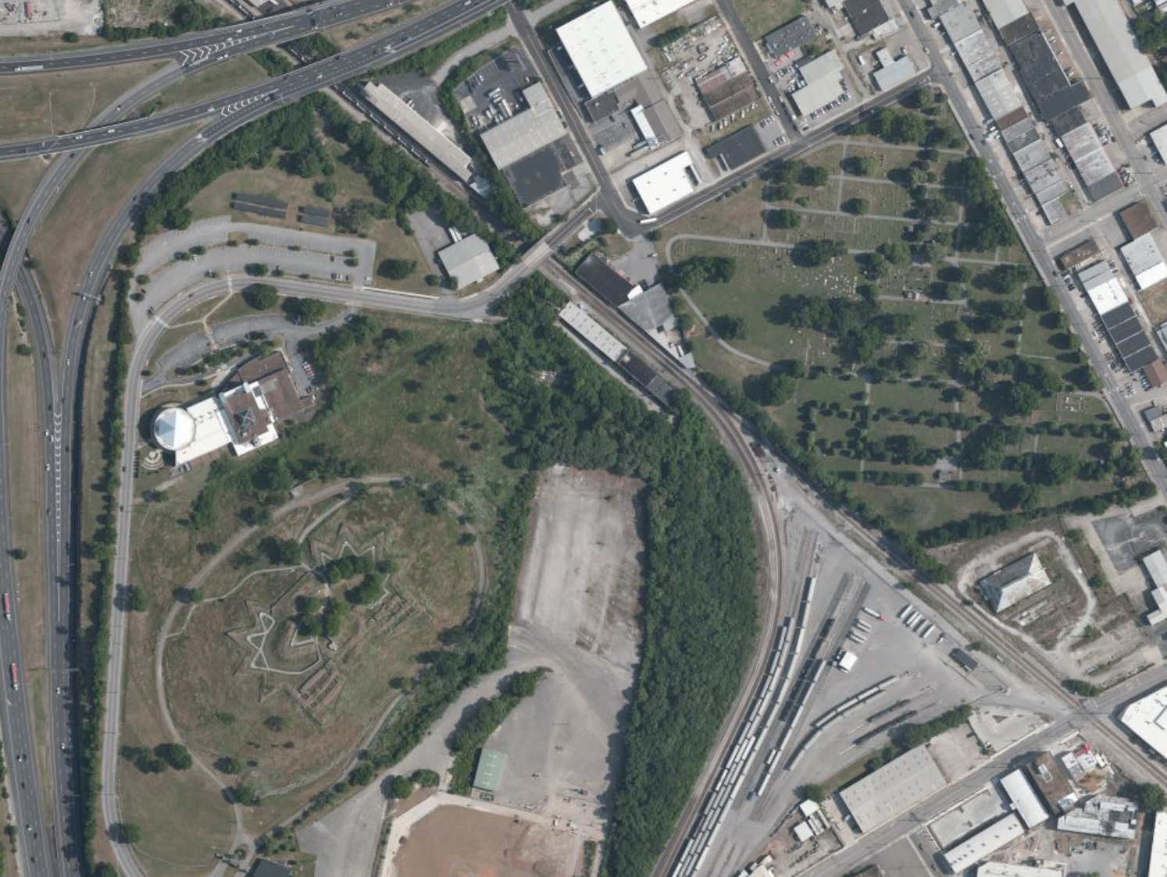
Most interred individuals were buried in the latter half of the nineteenth century, many of whom died of bacterial infections, with a large influx of burials coinciding with the civil war reaching Nashville.
The cemetery borders a Union fort, both of which are accessible by the public, and offer visitors incredible insights into the history of early Nashville.
Nashville City Cemetery
Union Fort Negley
Notes:
The most common cause of death of interred individuals was Tuberculosis, which was referred to as “consumption”, in reference to the fact that the disease seemed to “consume” those afflicted, whereas the second most common cause of death was Cholera. Like Tuberculosis, Cholera is a bacterial infection, so it appears that Nashville struggled to cope with bacterial outbreaks in the late 19th and early to mid 20th centuries. It wasn’t until the 1950s that TB treatments became especially commonplace, and the disease took the lives of many Nashvillians.
Next, looking at the number of burials per year, it appears that the majority of individuals were buried in the later half of the 1800s. The first spike, in the early 1850s. Coincides with a Cholera epidemic that ravaged Nashville’s population starting in 1850, contributing to one of the top causes of deaths of interred individuals. The second, larger spike in number of burials occurred during the mid 1860s, which coincided with several battles of the American civil war, namely the battles of Fort Henry and Fort Donelson, in 1862, and the battle of Nashville in December of 1864, which followed the Battle of Franklin, all four of which were decisive Union victories. Many soldiers from both Union and Confederate armies were interred here at the Nashville cemetery.
In fact, another Civil War era fort, Fort Negley, was constructed by Union forces in 1862 right next to the cemetery, though the fort itself never saw any action over the course of the war.
Today, both the cemetery and the fort are open to the public for recreational purposes, and it’s a great spot to go and discover tangible records of Nashville’s history, both about the city’s role in the course of the civil war, in addition to some early demographic data about the city, which the cemetery seems to serve as a kind of fingerprint for its population throughout the decades.

